Slide 1


Iniciativas Europeas para profesionalizar
la gestión de la investigación
Cristina Borrás
Directora Área Internacional
Agencia de Gestión de Ayudas Universitarias y de Investigación (AGAUR)
Cuenca, 13, 14 y 15 de noviembre de 2024

Slide 2


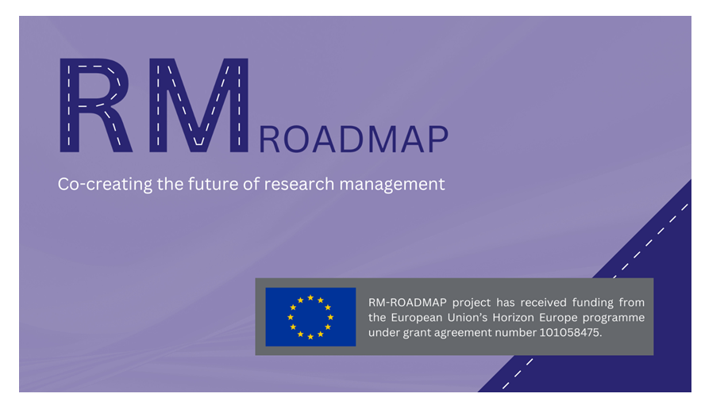
ERA Action 17 – Research Management Initiative
RECOGNISES the growing need for the professionalisation of science management at research-performing and funding organisations, to improve their ability to respond in ERA-wide collaboration networks.
Notes:
Millorar la capacitat estratègica de les organitzacions públiques d'investigació i finançament d'Europa

Slide 3

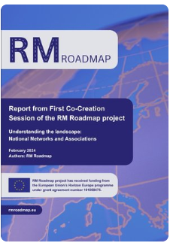
Creating Framework Conditions for Research Management to Strengthen the European Research Area
120 National Ambassadors
+ 30 Thematic Ambassadors
Connect new and existing networks on a community platform to:
create a bottom-up consensus about the future of RM
inform about the existing training, networking, funding and mobility opportunities
Clarify and showcase the RM added-value for the R&I ecosystem - Value proposition to stakeholders
Coordinador: EUROPEAN ASSOCIATION OF RESEARCH MANAGERS AND ADMINISTRATORS (EARMA)
Duration: September 2022 – August 2025
https://www.rmroadmap.eu/co-creation-results

Slide 4
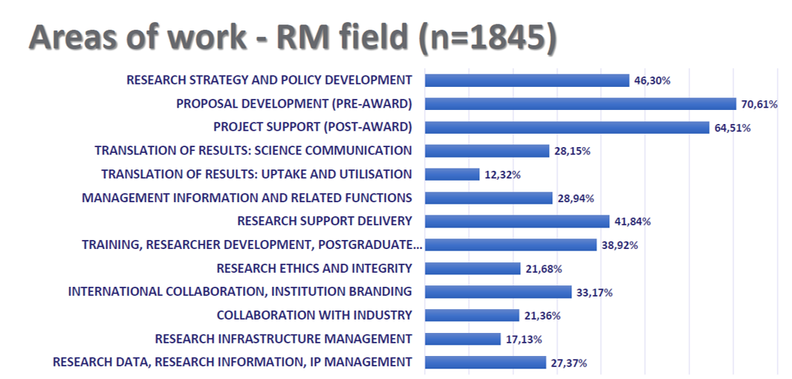
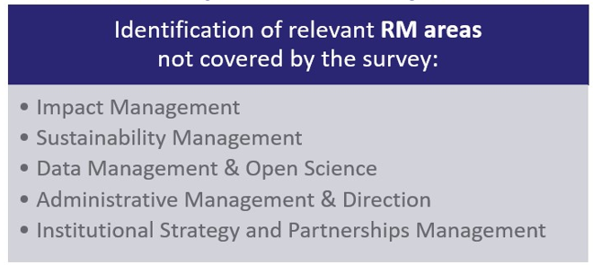
RM Roadmap – Survey Analysis
The term Research Manager is not defined but is inclusive and flexible:
research policy advisers, research managers, financial support staff, data stewards, data analysts, research infrastructure operators, knowledge transfer officers or business developers, innovation managers, etc.
New emerging roles!

Slide 5
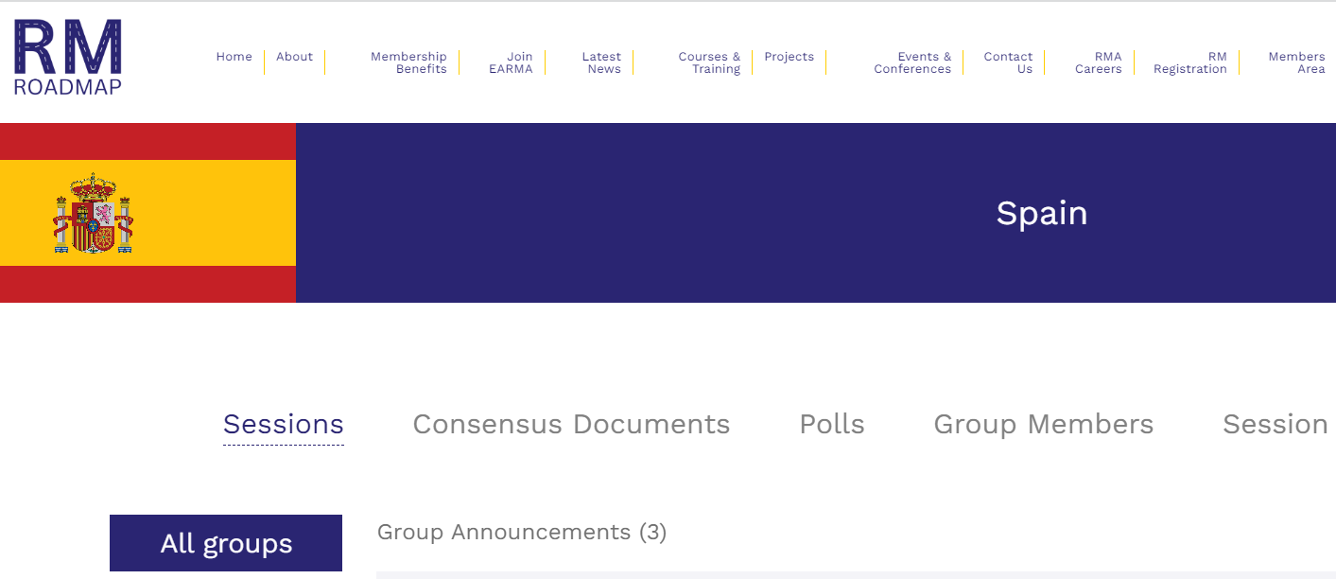
RM Roadmap Knowledge and Community Platform
RM Roadmap Knowledge and Community Platform - Online co-creation space for the Research Management (RM) community.
It gathers opinions on the outlook on the RM landscape across Europe, considering differences between countries.
3rd Co-creation session –
CAREER DEVELOPMENT FRAMEWORK
14 November – 19 December 2024
https://earma.org/roadmap/11/1212/

Slide 6

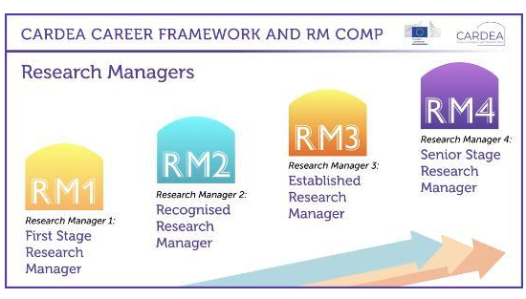
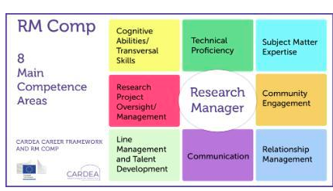
RM Career Framework & RM Competence Framework
Coordinador: UNIVERSITY COLLEGE CORK - NATIONAL UNIVERSITY OF IRELAND, CORK - UCC
Duration: June 2022 – May 2026
https://www.ucc.ie/en/cardea/competenceframework/

Slide 7
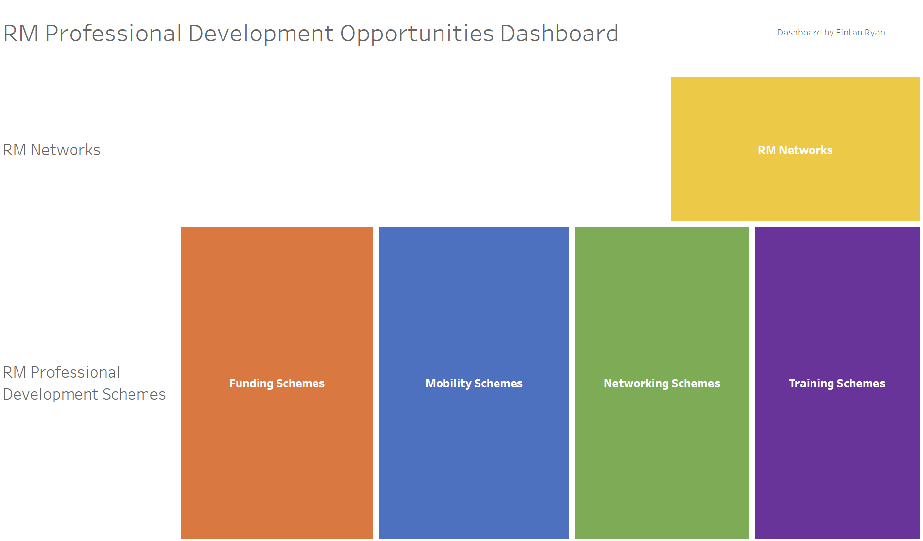
https://www.ucc.ie/en/cardea/dashboard/

Slide 8
RM Framework
To enable a European research management (RM) qualification system to achieve clarity and improved interoperability in RM in the ERA.
To set standards for training and career development, based on the competence frameworks (RM1-RM42) developed by the RM Roadmap and CARDEA projects.
To create a process that will certify any organisation that wishes to provide RM training using the principles, objectives, and quality standards of RM Framework through Quality Label(s).
Bringing together pilots from 9 different countries (ensuring inclusiveness and relevance), incorporating leadership perspectives to align RM practices with organizational goals and policy frameworks.
Coordinador: EUROPEAN ASSOCIATION OF RESEARCH MANAGERS AND ADMINISTRATORS (EARMA)
Duration estimated: February 2025 – January 2027

Slide 9

¡Muchas Gracias!
Cristina Borrás
Directora Área Internacional
Agencia de Gestión de Ayudas Universitarias y de Investigación (AGAUR)
cborrass@gencat.cat
https://agaur.gencat.cat/es/internacional/
CARMA. Red de gestores de
Investigación en Catalunya

